Slide 1

AI Workshop
By Muhamad Nur Rohman
Day 4
July 12, 2022

Slide 2
Topics
1. Dataset pre-processing | : | Normalization (input and output) | Day 1
 |  | Randomization (shuffle)
 |  | Dataset division (training, validation, and testing)
 |  | Dataset division using cross validation
2. Variable importance analysis | : | Random forest | Day 1
3. AI-based modeling | : | Support vector machine (SVM/SVR) | Day 2
 |  | Random forest for classification/regression
 |  | ANN/DNN
4. Metaheuristic optimization | : | Particle swarm optimization (PSO) | Day 3
5. Hybrid AI-based model – metaheuristic optimization (Hyperparameter tuning) | : | SVR-PSO ANN-PSO DNN-PSO ANN/DNN fine-tuning | Day 4
6. Optimization using machine learning model | : | PSO-SVR | Day 5
7. Object measurement | : | Computer vision / OpenCV | Day 6

Slide 3
Hyperparameters
SVR
ANN
Etc.
model = SVR(kernel = 'rbf',C=50, epsilon=0.1)
model = SVR(kernel="poly", C=50, gamma="auto", degree=3,
epsilon=0.1, coef0=0.01)
model = Sequential()
model.add(Dense(150, input_dim=3, activation='relu'))
model.add(Dropout(0.2))
model.add(Dense(1, activation='sigmoid'))
model.compile(loss='mean_absolute_error',
optimizer=Adam(lr=0.0005,beta_1=0.95,beta_2=0.999))

Slide 4
SVR Hyperparameter tuning using PSO
model = SVR(kernel = 'rbf',C=50, epsilon=0.1)
Optimize:
C, epsilon
+ Random seed number (Kang et al., 2019)
Objective:
Minimize: MAPE training & MAPE testing
0 < C ≤ 100
Subject to:
0 ≤ epsilon ≤ 1
0 ≤ RSN ≤ 100

Slide 5
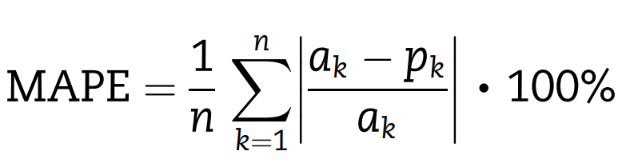
X_{i,j} = LB_{j} + rand(0,1)*(UB_{j}-LB_{j})
Population initialization
Variable | LB | UB
C | 0 | 100
epsilon | 0 | 1
RSN | 0 | 100
Evaluate the fitness
Save the Pbest and Gbest
Update the rate and position
MAPE training & MAPE testing
With 5-fold cross validation
Boundary handling
N
Stopping criteria satisfied?
MAPE = mean absolute percentage error
Y
Maximum number of iteration or convergent
Optimal solution

Slide 6
Population
Particle No. | C | epsilon | RSN
1 | 21.86 | 0.53 | 33
2 | 57.04 | 0.95 | 12
3 | 91.72 | 0.67 | 71
4 | 18.22 | 0.14 | 51
… | … | … | …
N | 20.06 | 0.28 | 14
float
Integer

Slide 7
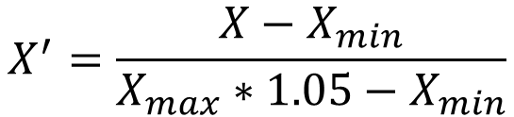
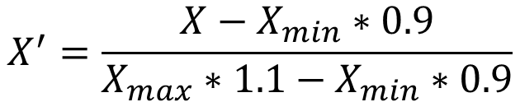
Dataset pre-processing
Input normalization:
$$X^{′}=\frac{X−X_{min}∗0.9}{X_{max}∗1.1−X_{min}∗0.9}$$
Output/target normalization:
= 0
$$X^{′}=\frac{X−X_{min}}{X_{max}∗1.05−X_{min}}$$
= 0

Slide 8
DNN Hyperparameter tuning using PSO
model = Sequential()
model.add(Dense(D1, input_dim=3, activation='relu'))
model.add(Dropout(DO1))
model.add(Dense(D2, activation ='relu'))
model.add(Dropout(DO2))
model.add(Dense(1, activation='sigmoid'))
model.compile(loss='mean_absolute_error',
optimizer=Adam(lr=0.0005,beta_1=0.95,beta_2=0.999))
Optimize:
D1, D2, DO1, DO2
+ Random seed number
Objective:
Minimize: MAPE training, MAPE validation, and MAPE testing
Subject to:
0 < D1,D2 ≤ 200 ;
0 ≤ RSN ≤ 100
0 ≤ DO1, DO2 ≤ 0.5 ;

Slide 9
DNN Hyperparameter tuning using PSO
Exercise 15
model = Sequential()
model.add(Dense(D1, input_dim=3, activation='relu'))
model.add(Dropout(DO1))
model.add(Dense(D2, activation ='relu'))
model.add(Dropout(DO2))
model.add(Dense(D3, activation ='relu'))
model.add(Dropout(DO3))
model.add(Dense(1, activation='sigmoid'))
model.compile(loss='mean_absolute_error',
optimizer=Adam(lr=0.0005,beta_1=0.95,beta_2=0.999))
Optimize:
D1, D2, D3, DO1, DO2, DO3
+ Random seed number
Objective:
Minimize: MAPE training, MAPE validation, and MAPE testing
Subject to:
0 < D1,D2,D3 ≤ 200 ;
0 ≤ RSN ≤ 100
0 ≤ DO1, DO2, DO3 ≤ 0.5 ;

Slide 10
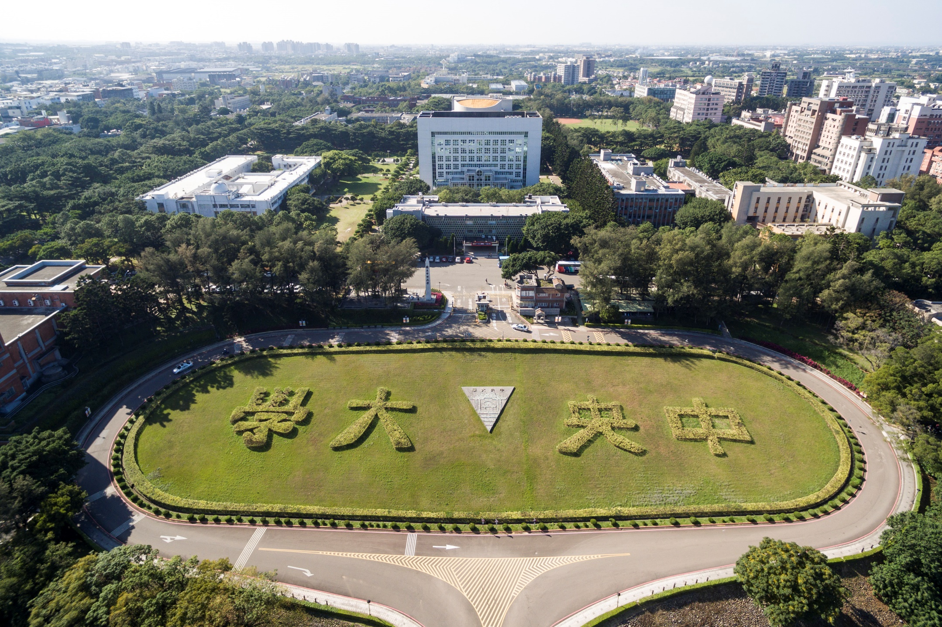
Thank you for your attention

